Slide 1
Original Finsta: Milestone 4
Teresa, Jose, Haris, Anh, Kim

Slide 2
Progress Report
Implemented 3 main functions: hashtags, push notifications, private messaging
Hashtag
Search by hashtag
Follow/unfollow hashtag
Push notification
When someone liked/commented your post
When someone started to follow you
Private messaging
Can message people followed and being followed
Real time chat
Push Notification when receiving a message
Social media login
Extract email, name and profile picture from social media account
Improved existing feature
Creating post with multiple pictures and after taking a new photo can crop the photo

Slide 3
Hashtag
Database
`Tags` collection
Each tag has its name and all post_ids of the post has this hashtag
Tag profile
Get all the posts from tag provided
Follow/Unfollow tag
Add/delete tag in user’s `tagfollows` collection
Generating main feed
Also check if post has a tag in tagfollows list
Display tag name instead of username in the post

Slide 4
Push Notification
Using Firebase Cloud Functions to listen for the change
New follower
New like
New comment
New message
Using Firebase Cloud Messaging to generate notification
Getting device token upon signing in and store in database with user’s information
When cloud functions triggered by changes, get receiver device token from database and send to device

Slide 5
Private messaging
Database
Chatroom collection
Two user start a conversation will create a chatroom with id of two user’s uid combined
All messages stored in chatroom collection
Each message has timestamp, content, sender and receiver (for notification)
Get messages from backend when chat page opened
Then listen for changes in chatroom messages to update UI for both users
Only two people followed each other can do private messaging

Slide 6
The future work (desired features)
Performance optimization using local storage
Rank hashtags (based on how many posts that have the hashtag)
Suggest users to follow
Be able to reply to a comment

Slide 7
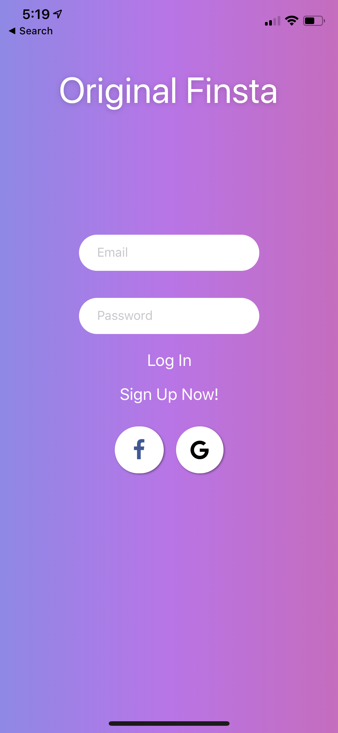
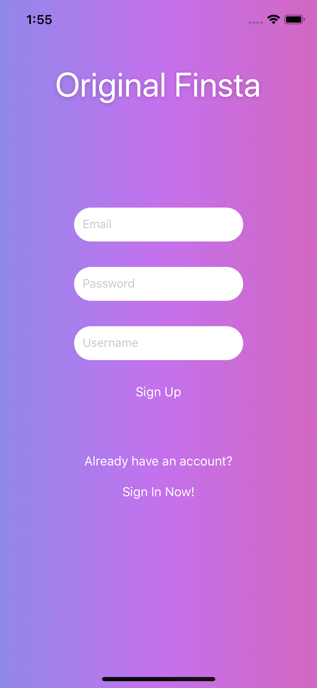
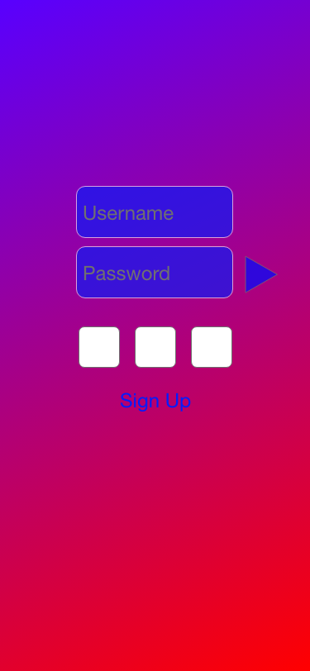
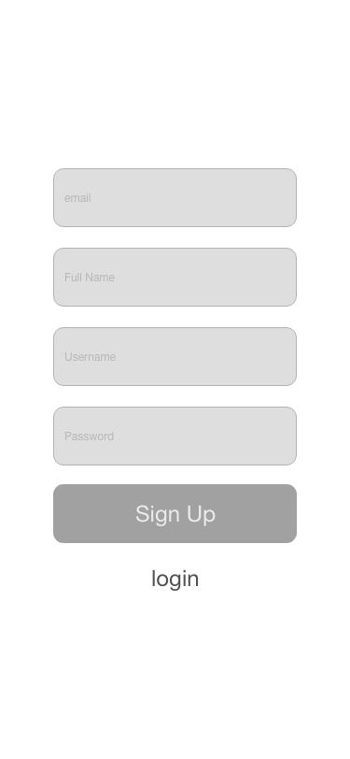
UI Comparison
Sign In and Sign Up Page
vs.

Slide 8
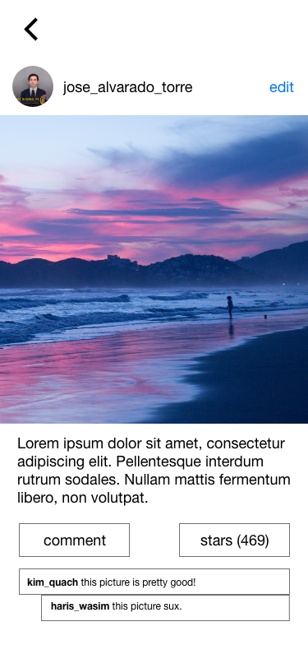
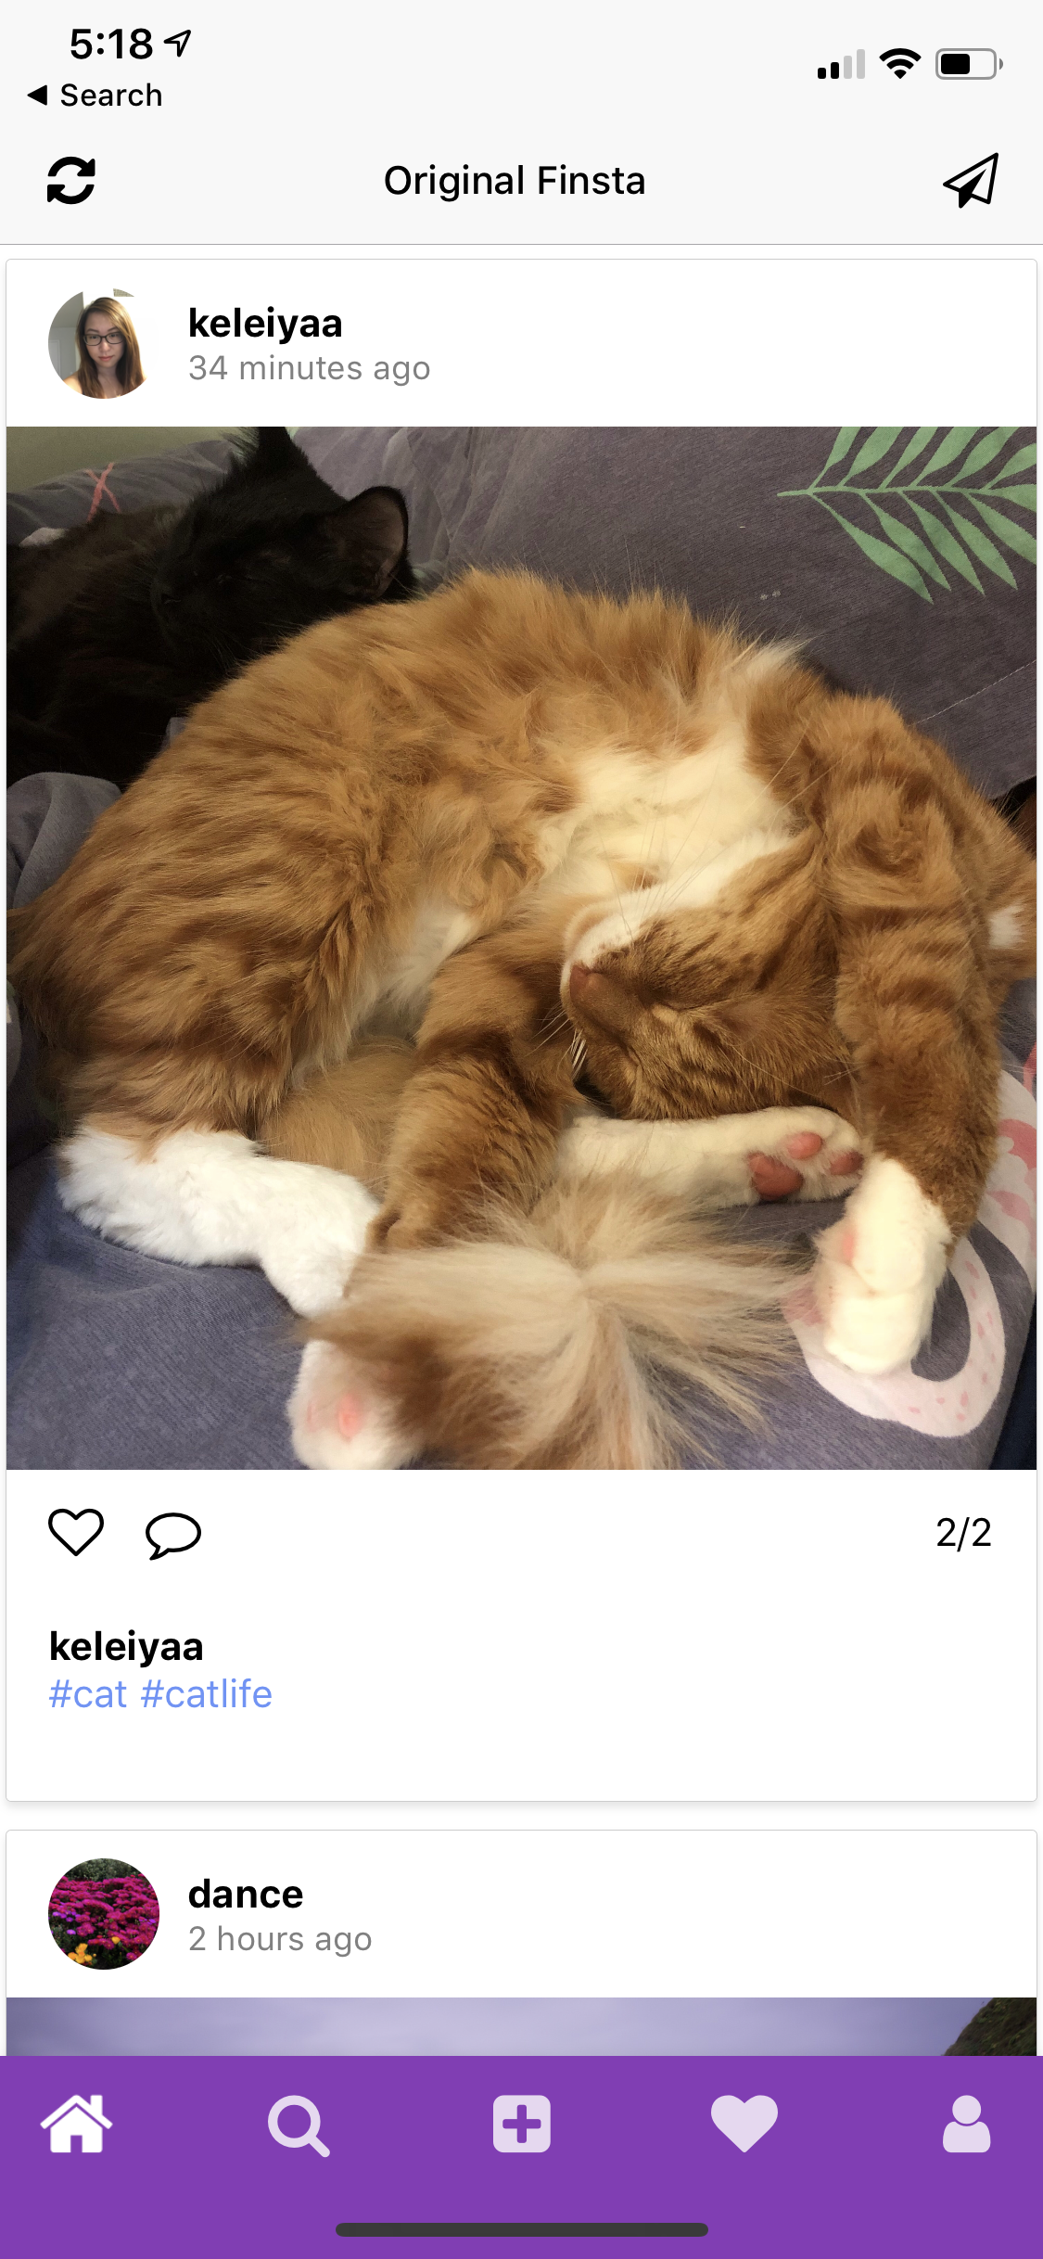
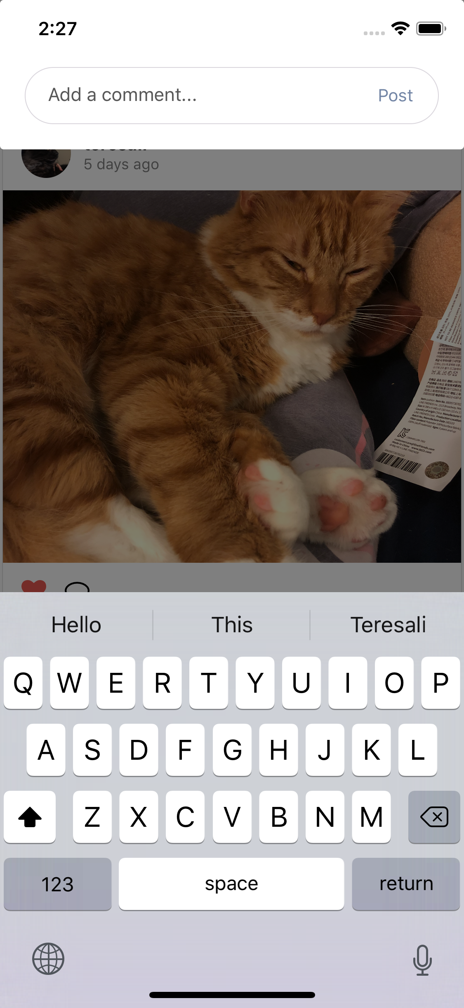
UI Comparison (cont.)
Main Feed, Like and Comment Post
vs.

Slide 9
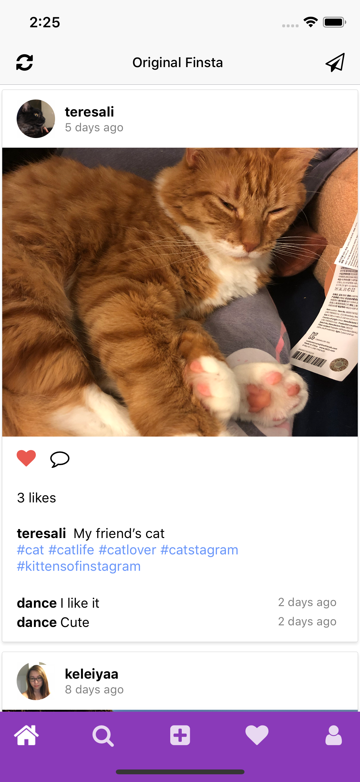
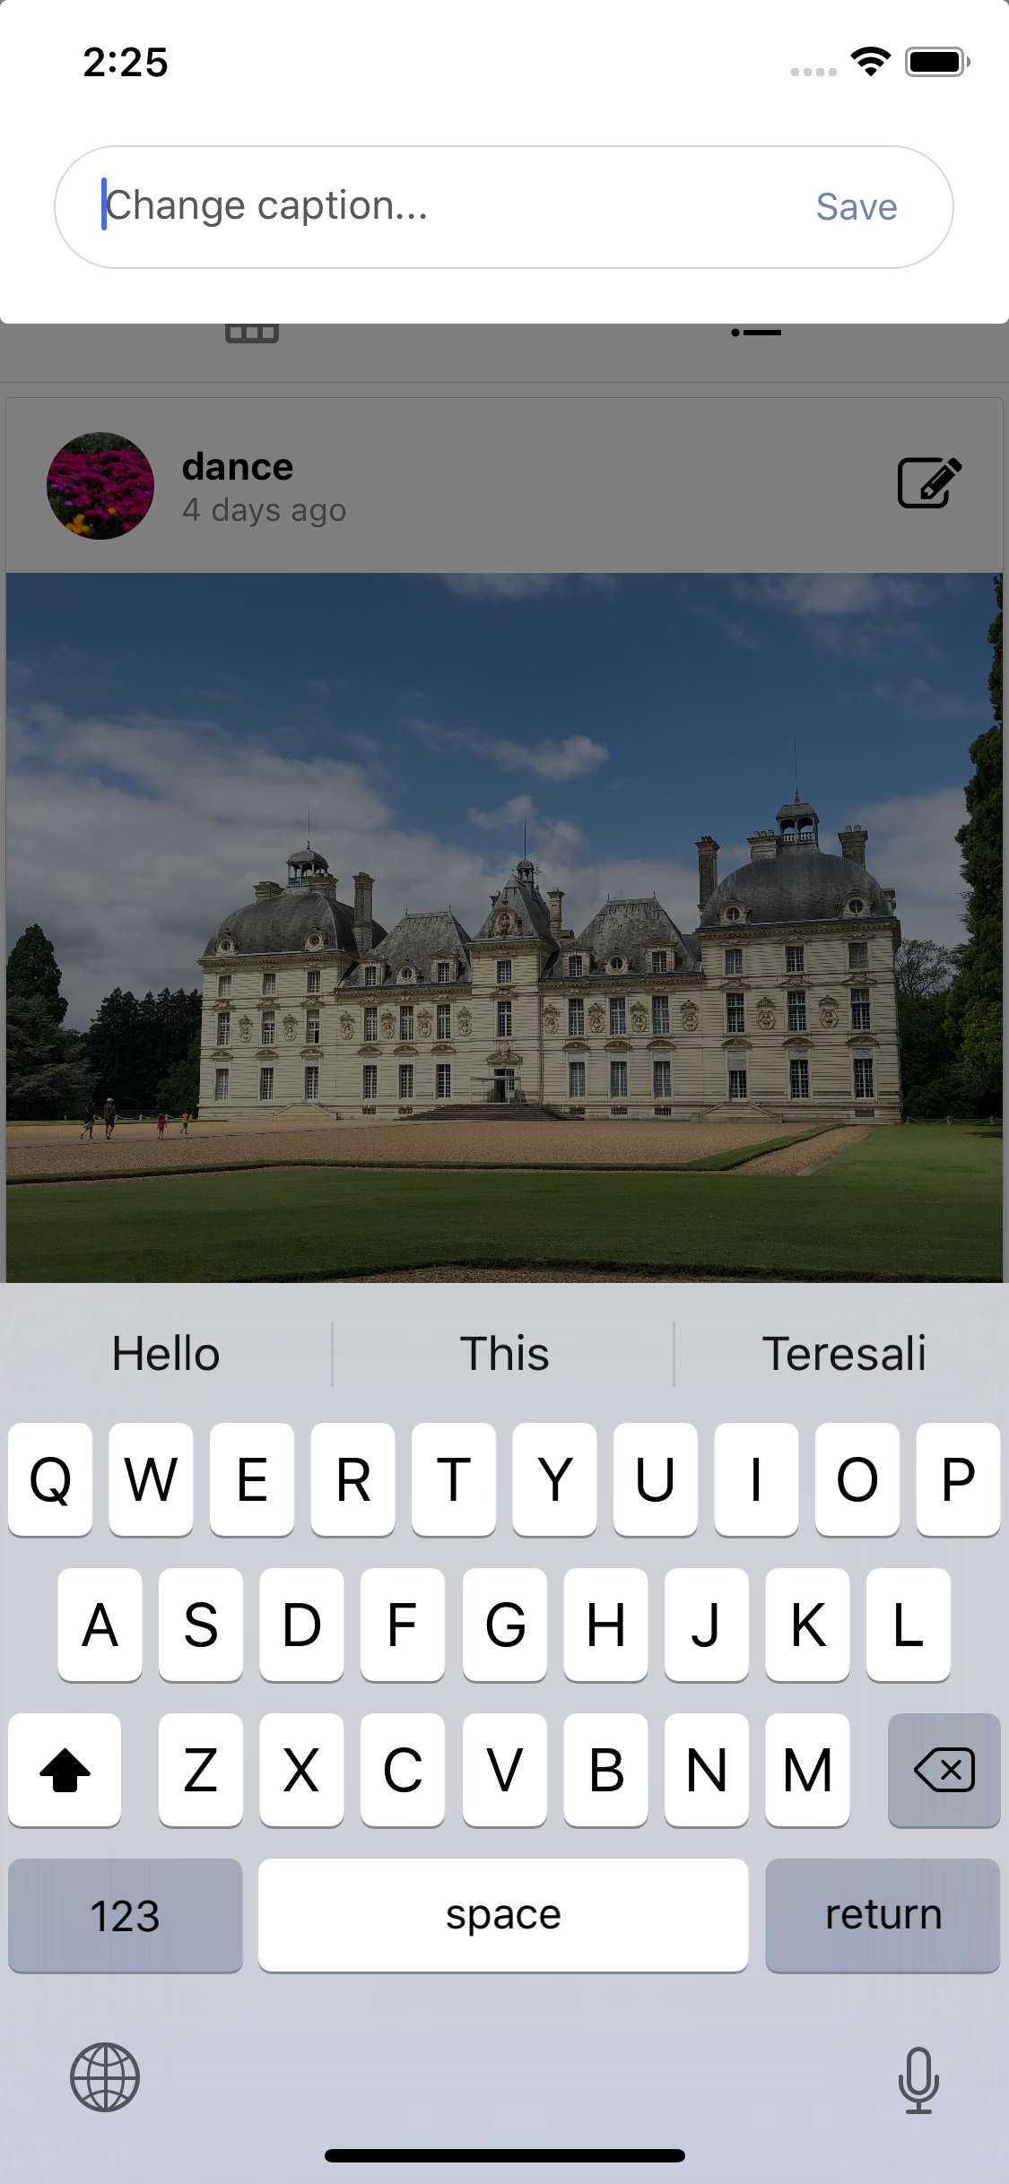
UI Comparison (cont.)
Edit Post
vs.

Slide 10
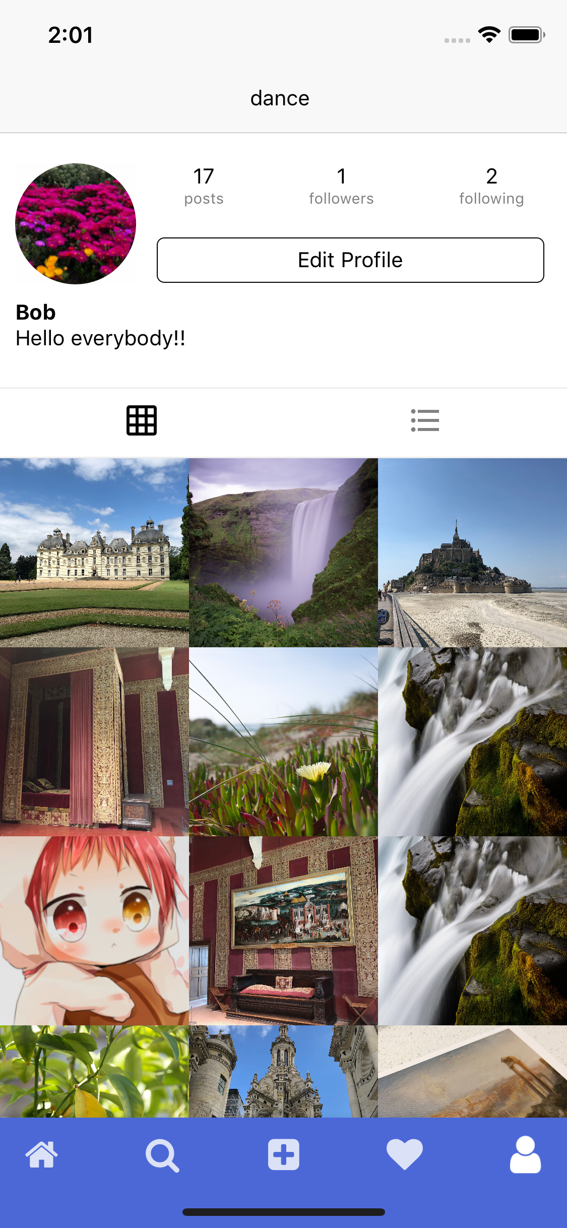
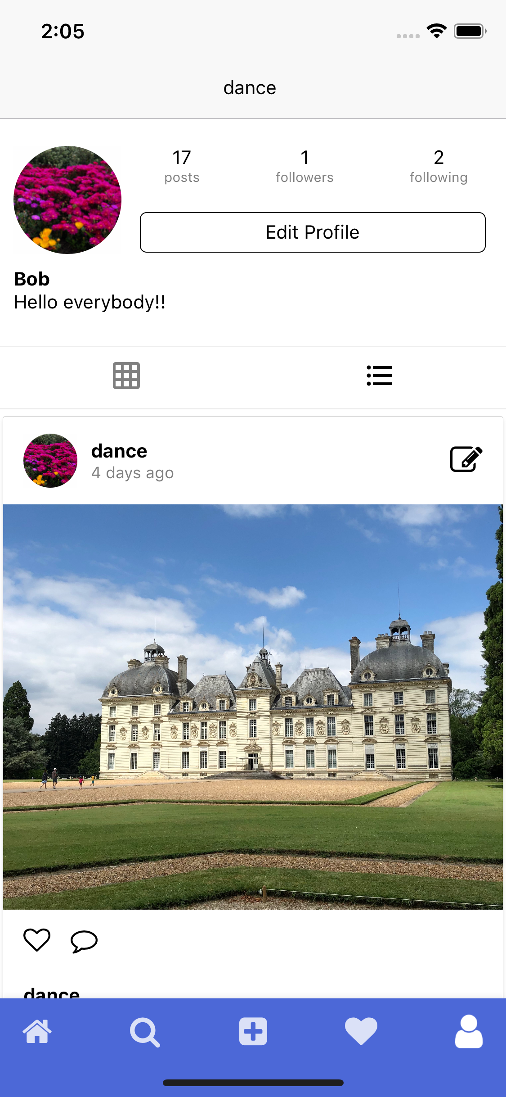
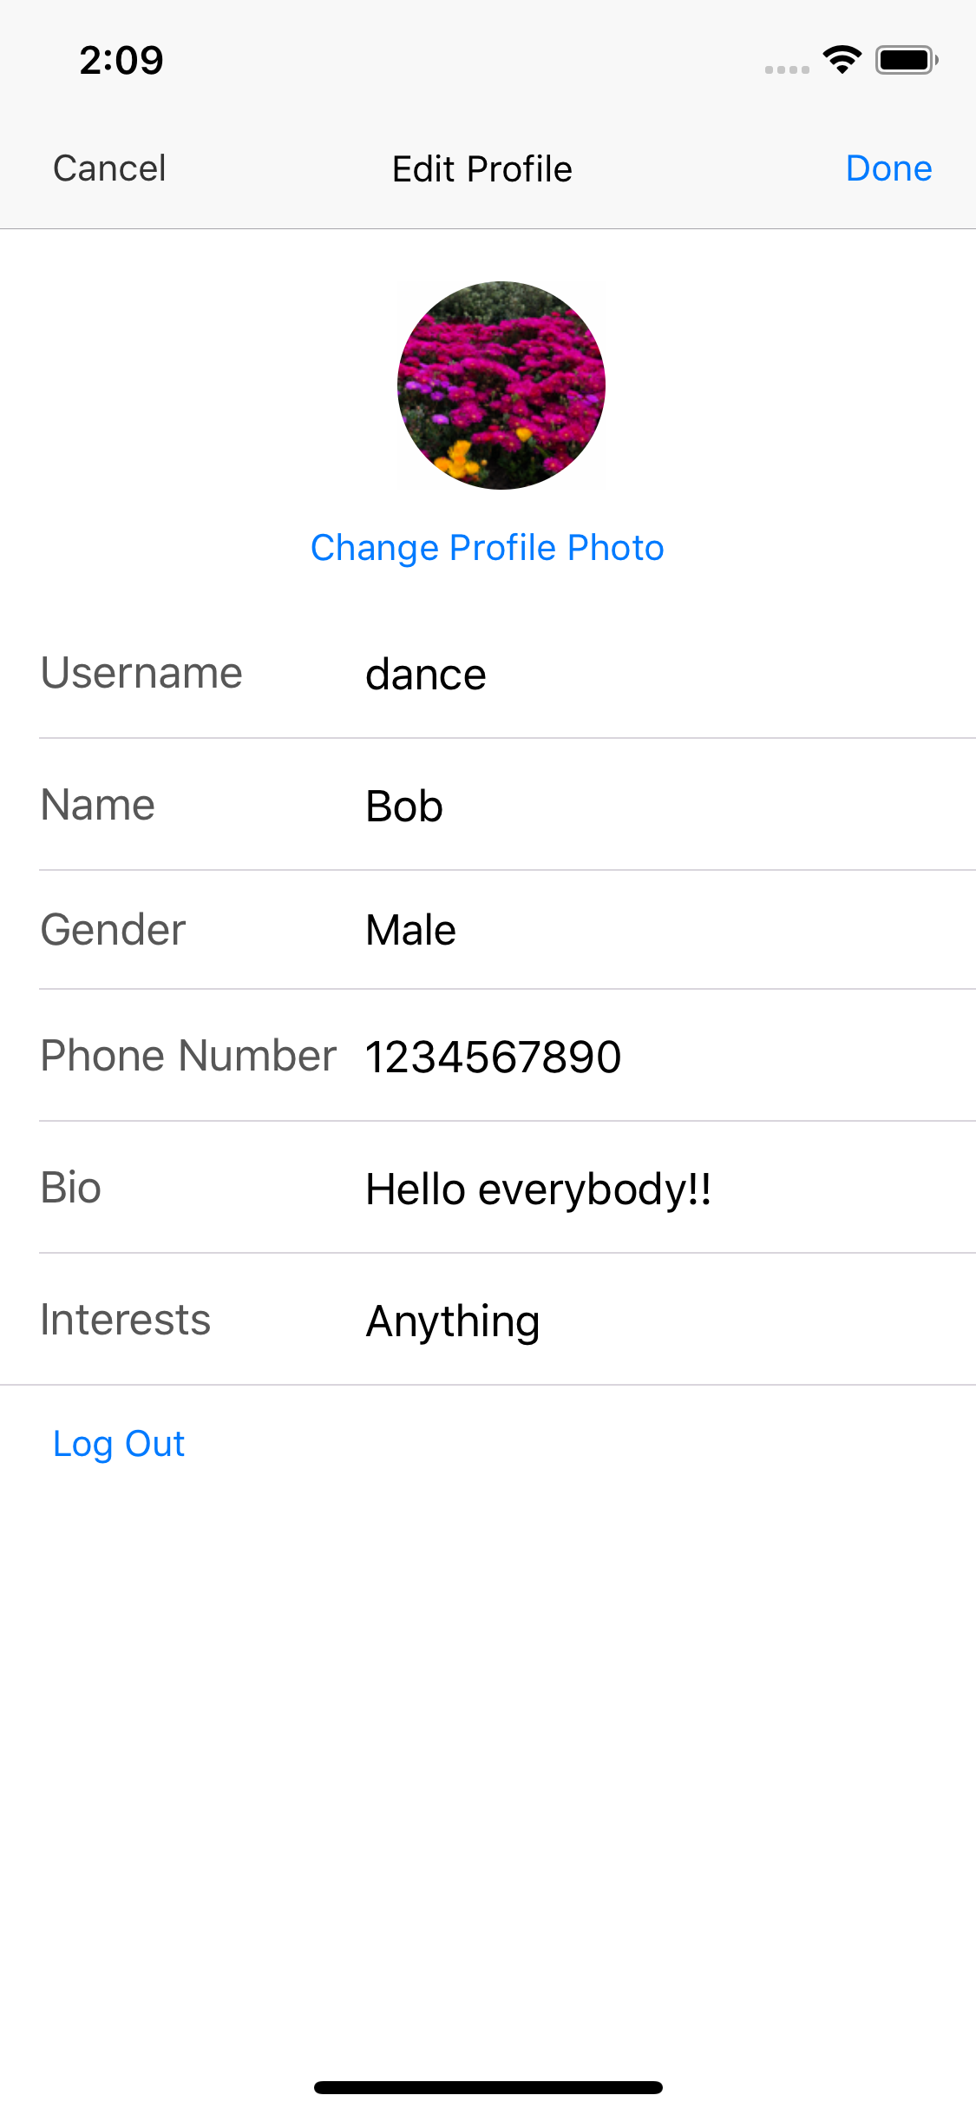
UI Comparison: User Profile Page
vs.

Slide 11
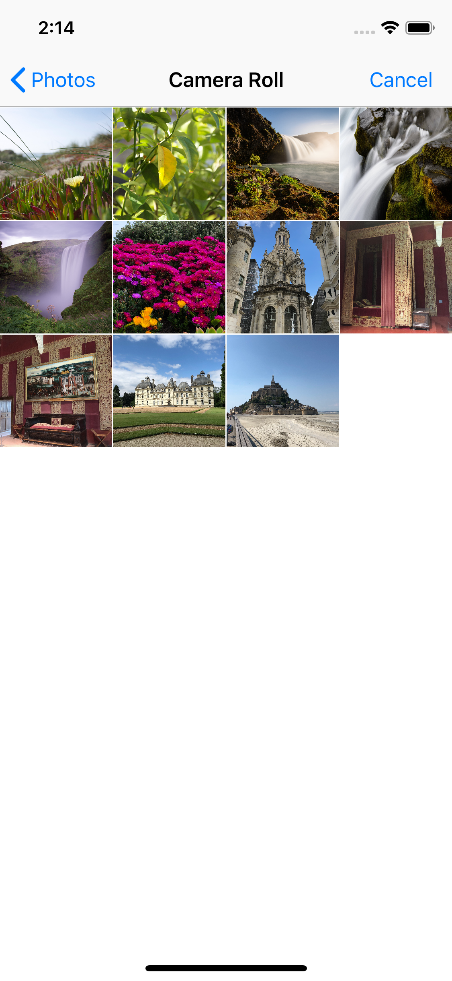
UI Comparison: Choose Image Page
vs.

Slide 12
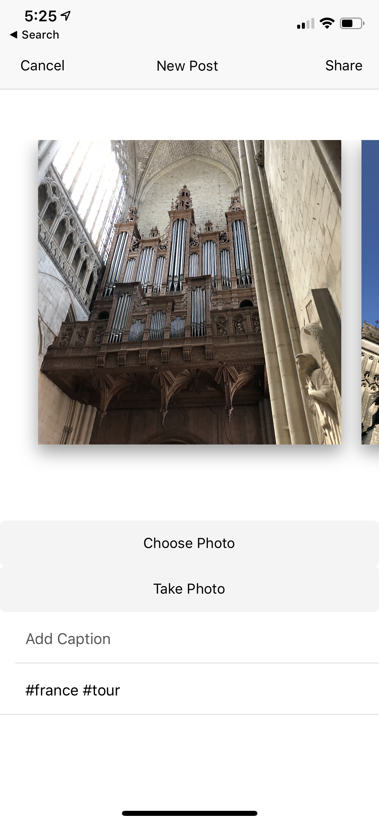
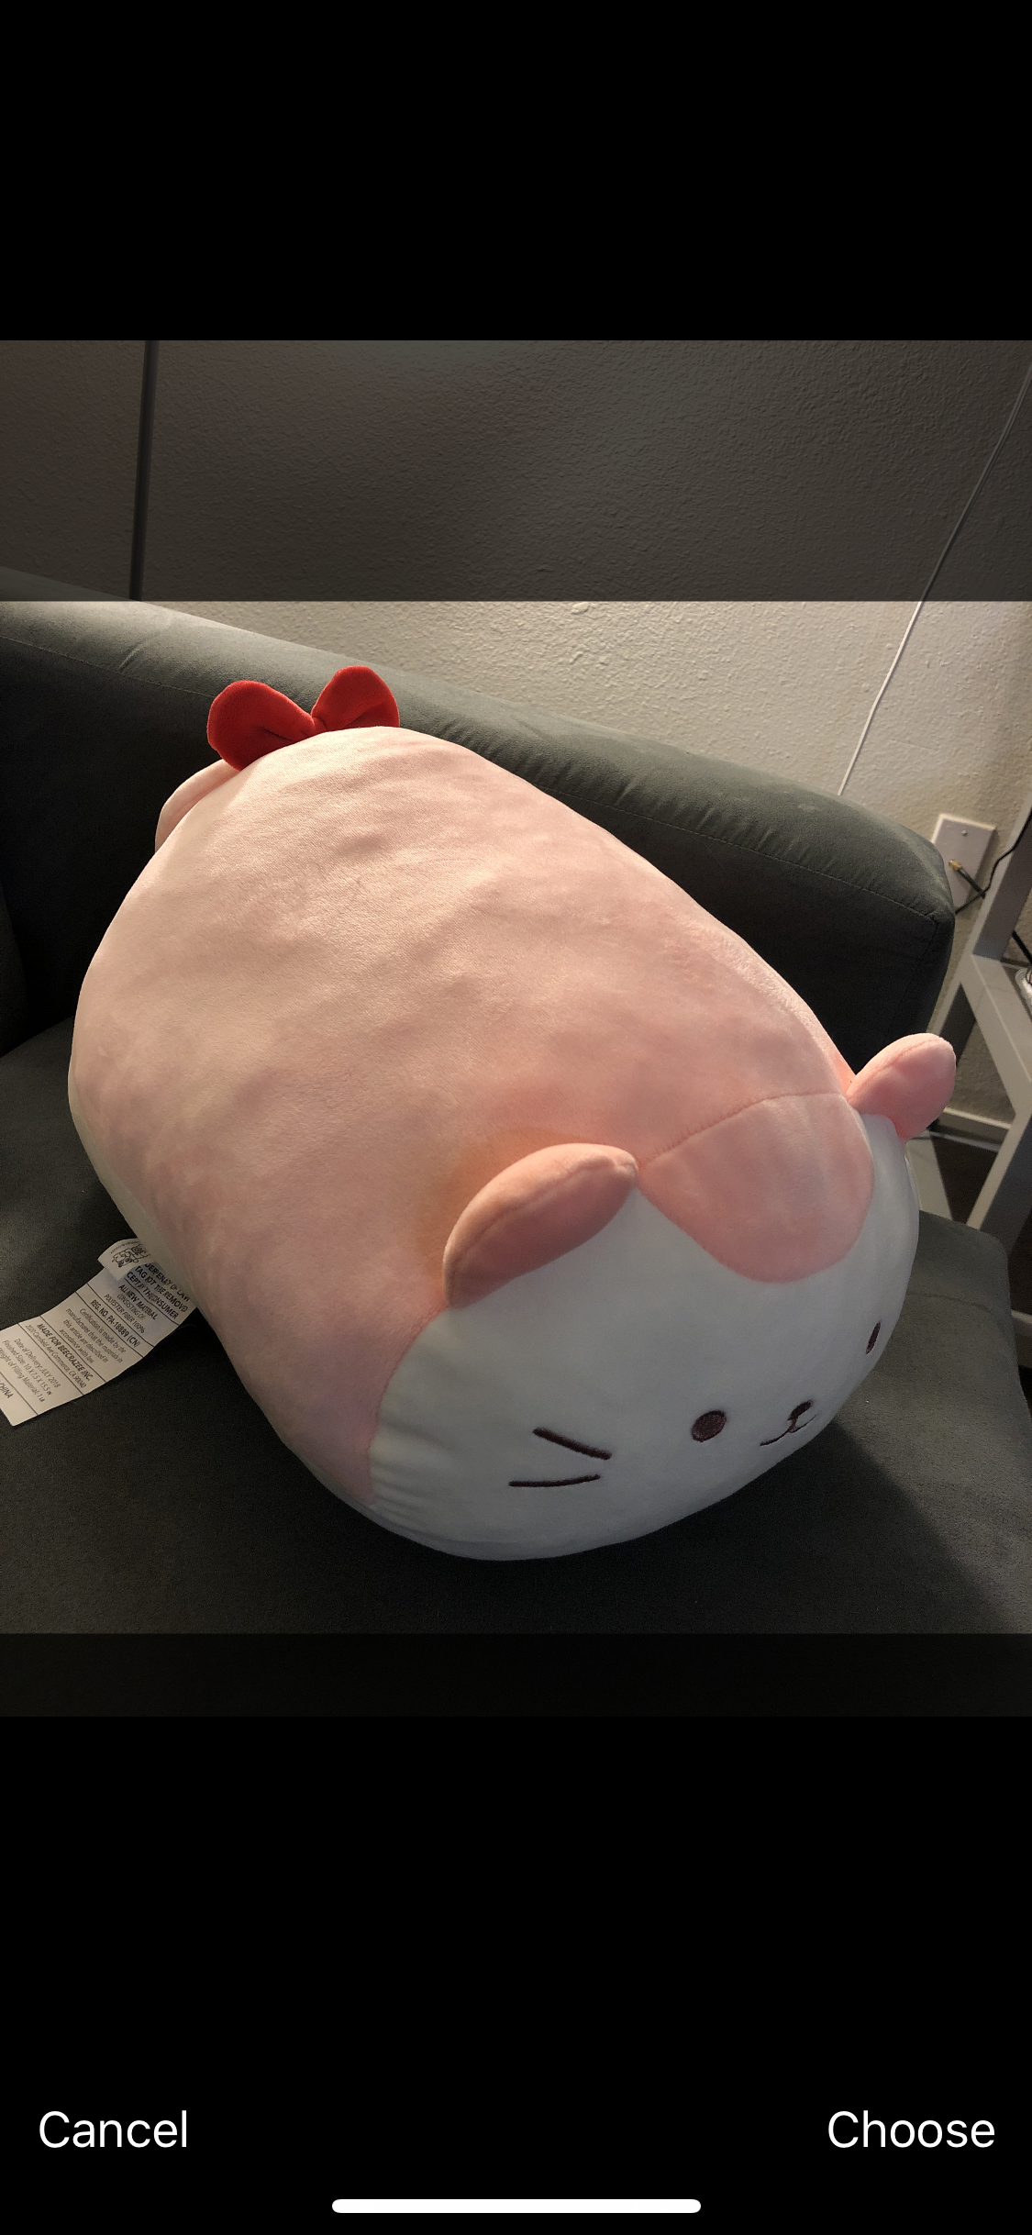
UI Comparison (new pages)
Create Post Page

Slide 13
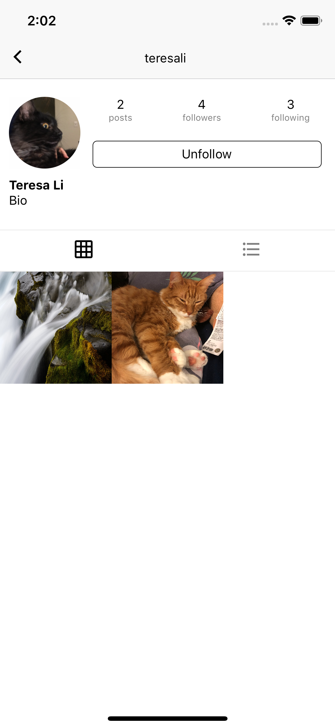
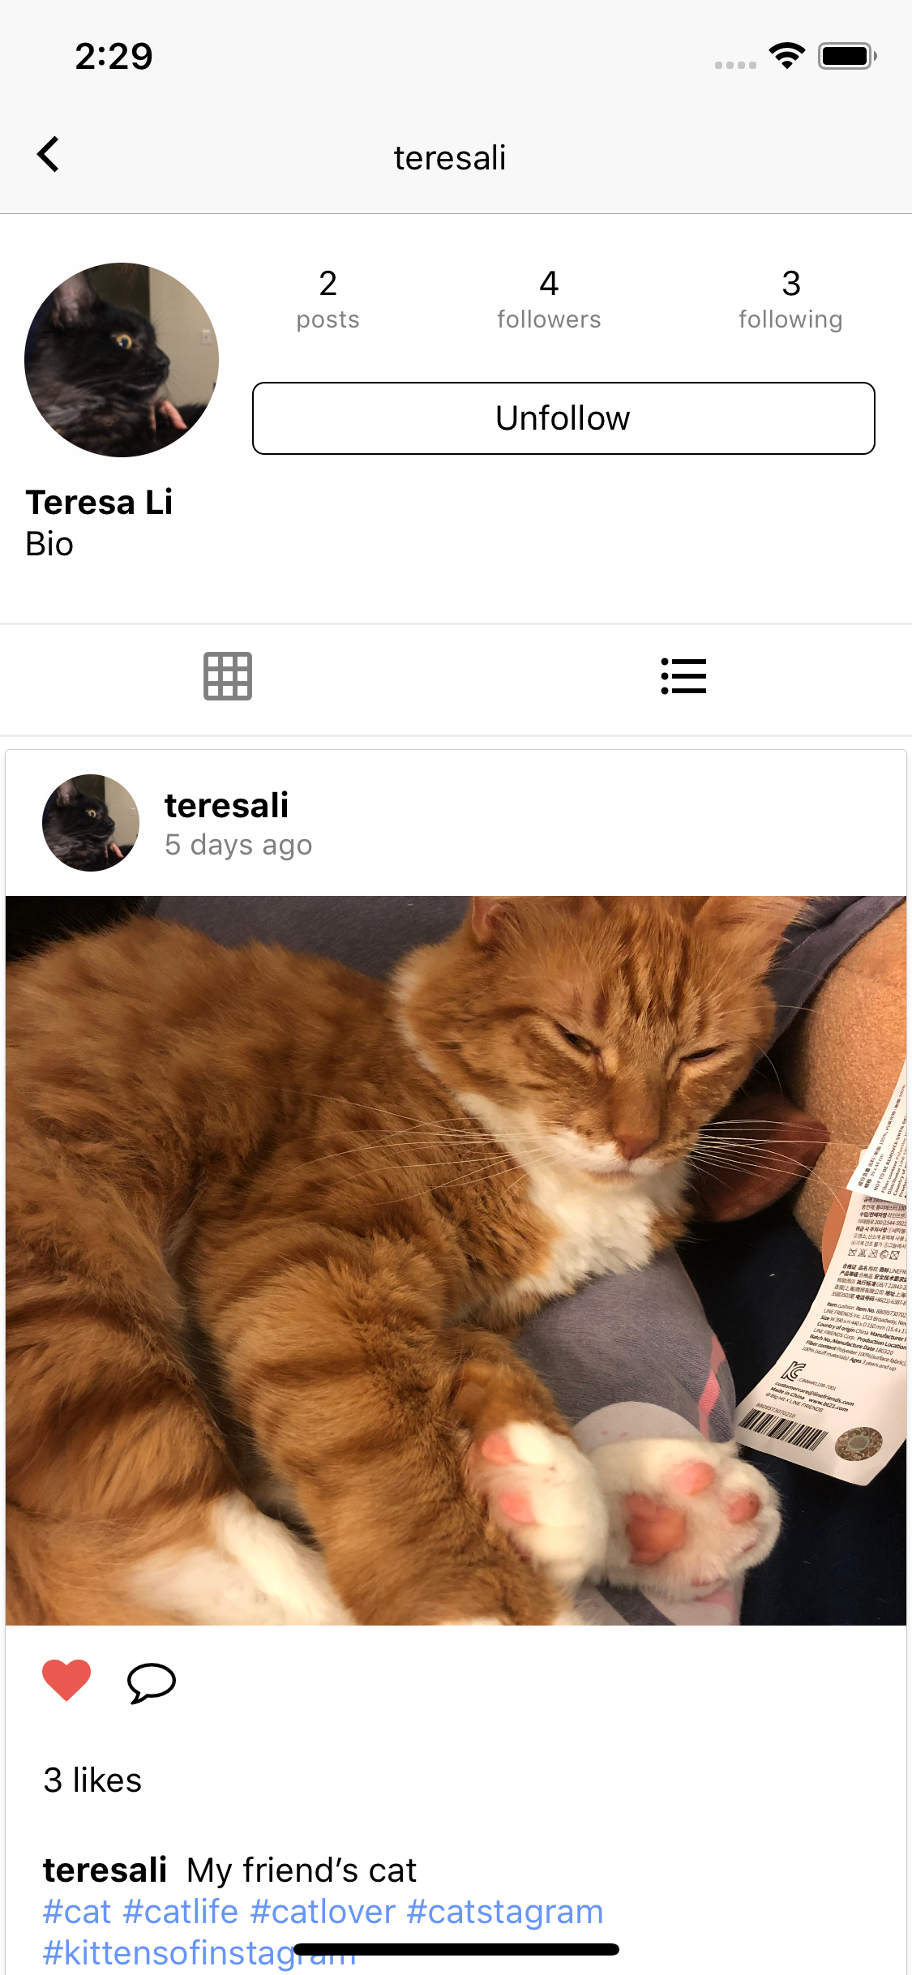
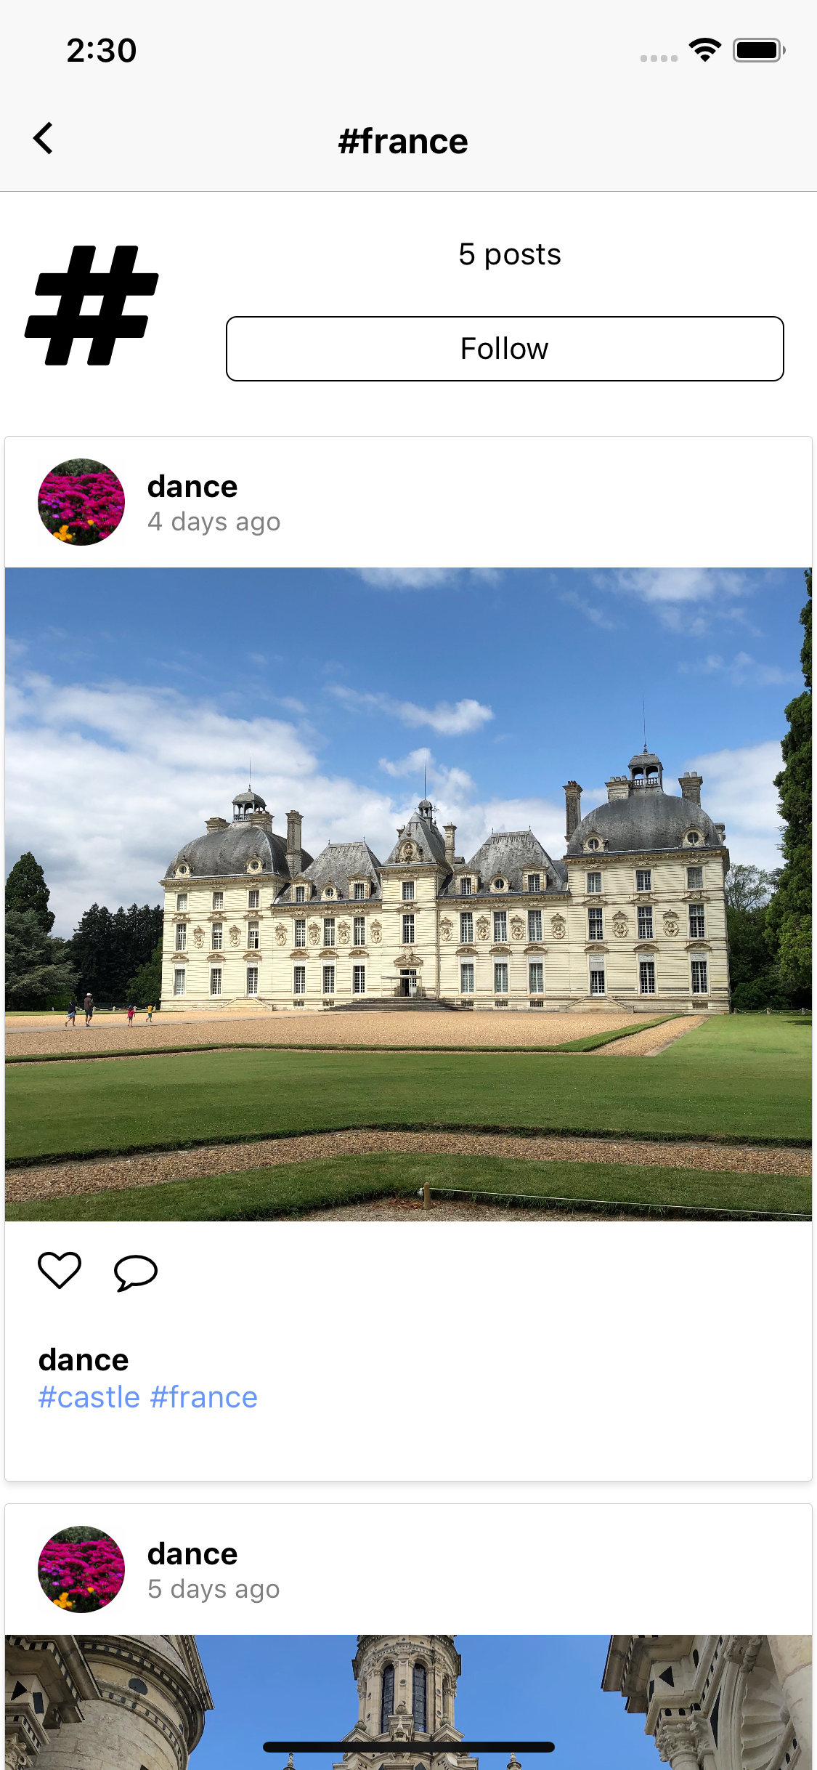
UI Comparison (new pages)
Other profile page and tag profile page

Slide 14
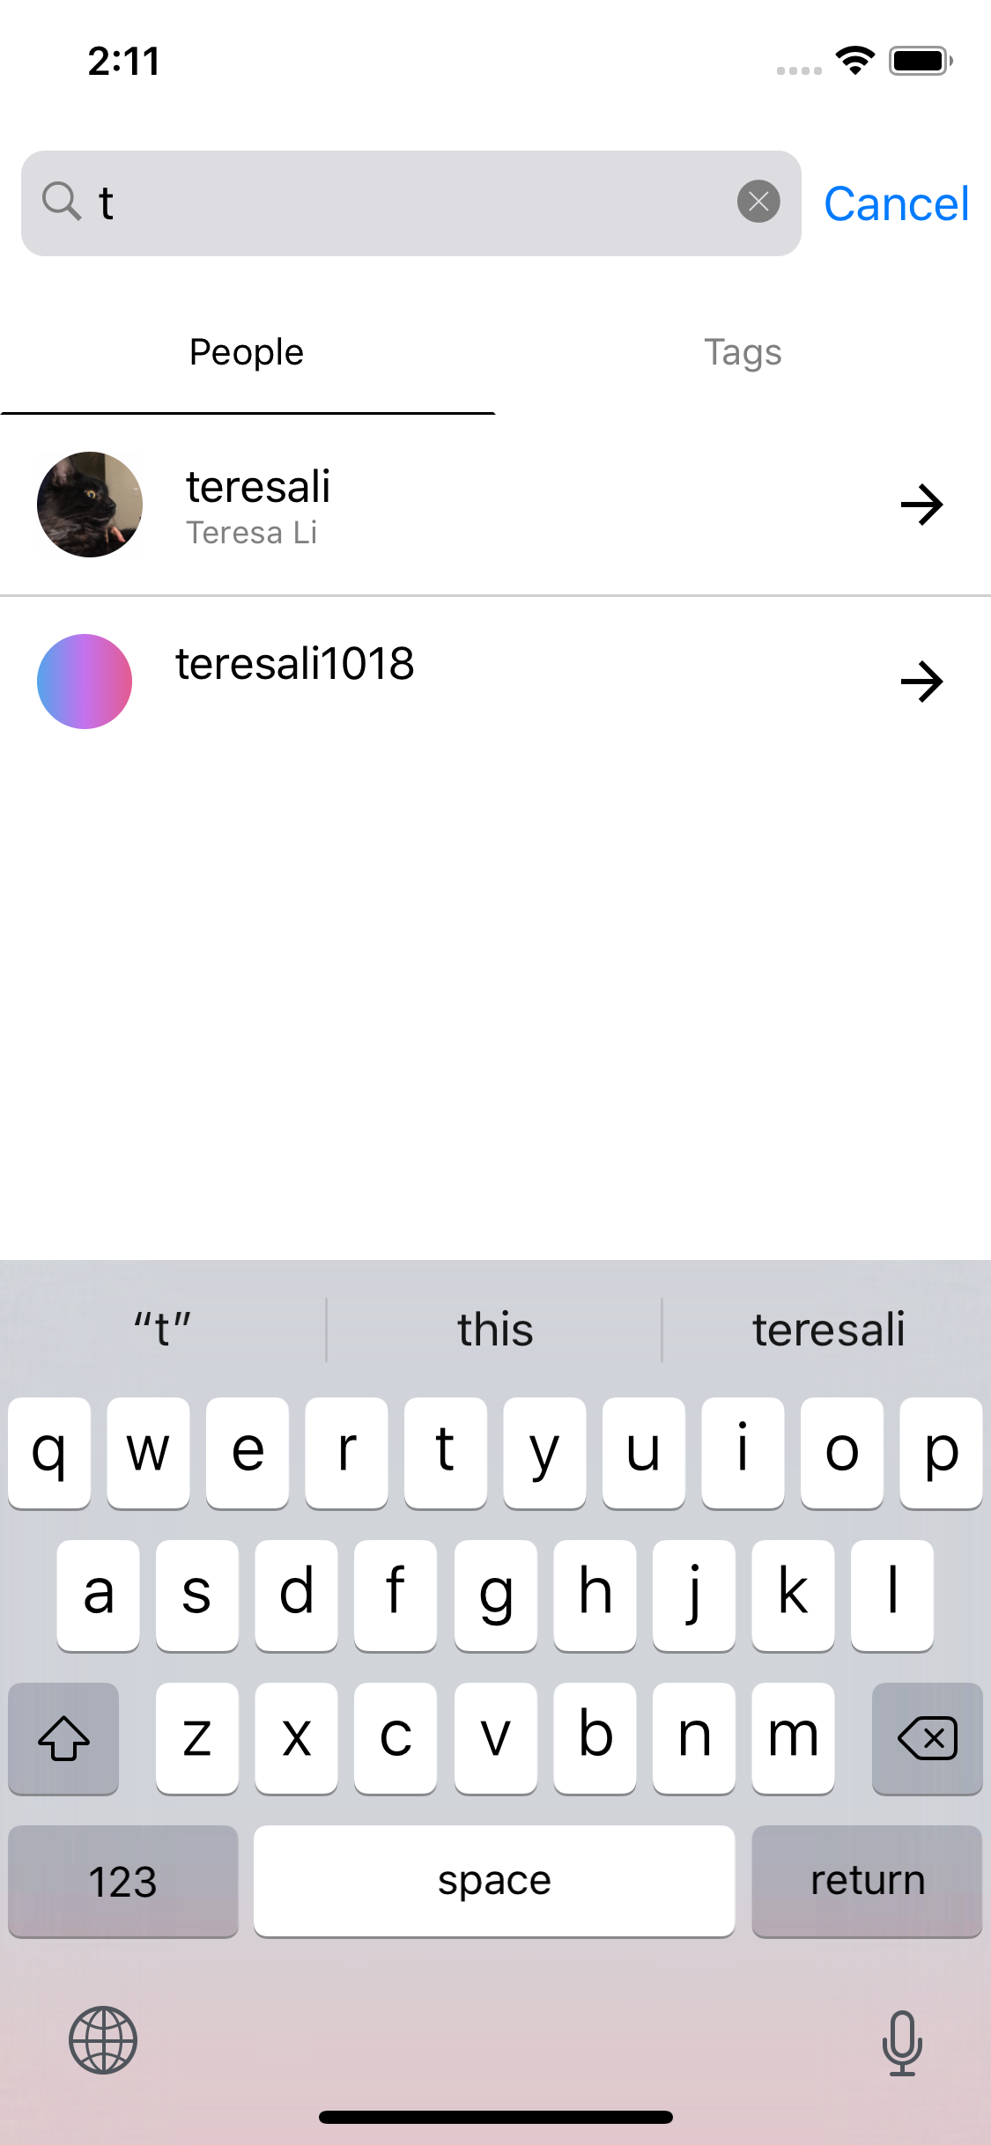
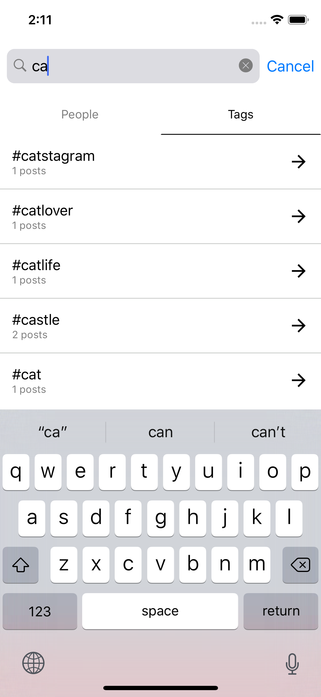
UI Comparison (new pages)
Search and Likes Page

Slide 15
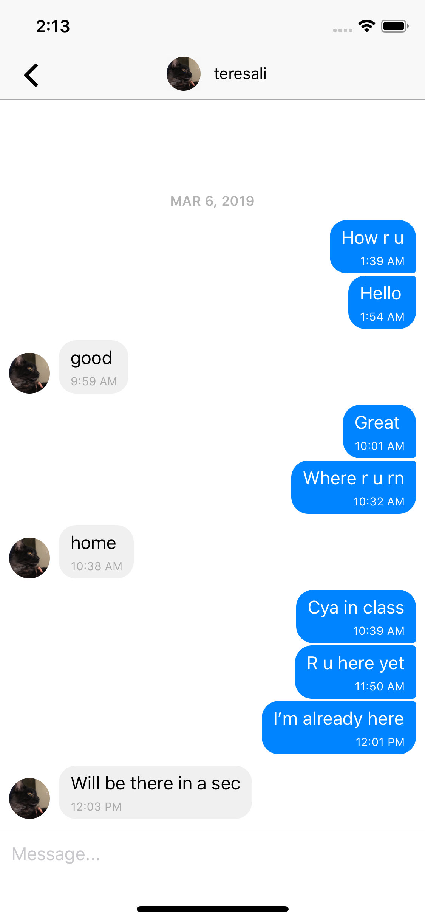
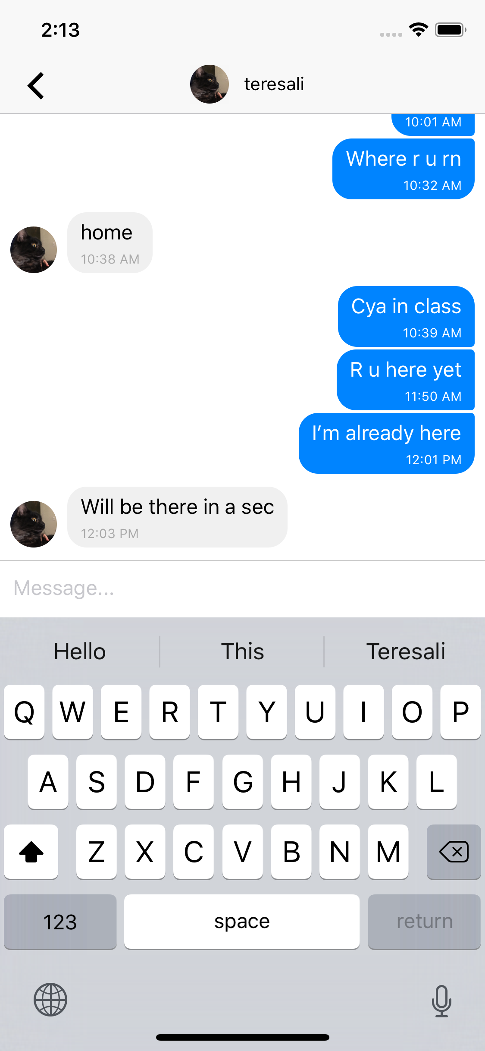
UI Comparison (new pages)
Private messaging pages

Slide 16
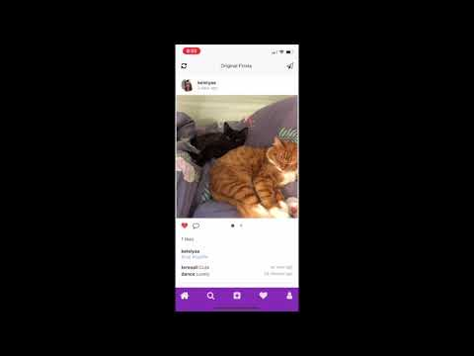
Live demo
Hashtag #

Slide 17
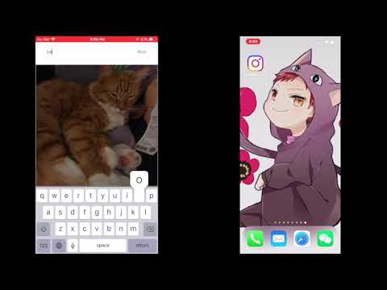
Live demo
Push Notification

Slide 18
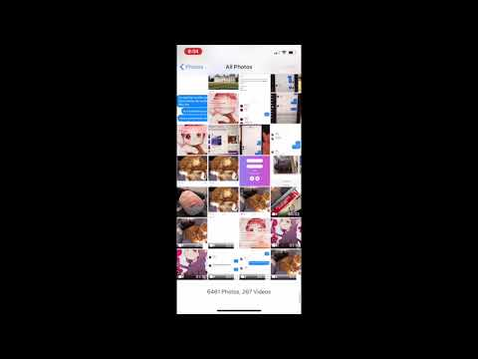
Live Demo
Improved existing
features

Slide 19
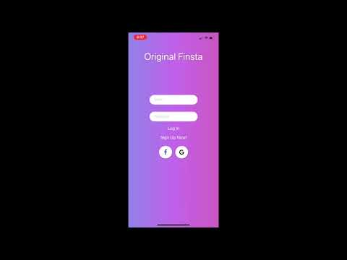
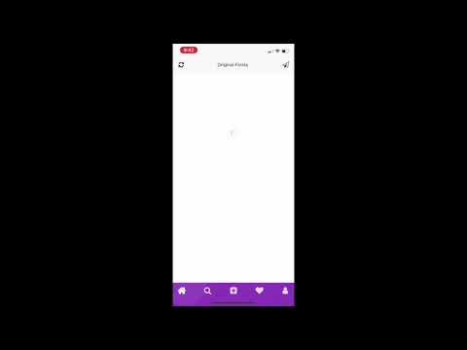
Live Demo: Social Media Login

Slide 20
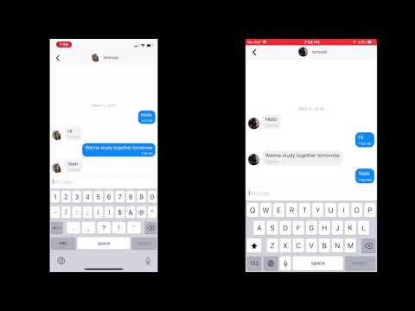
Live demo
Private Messaging

Slide 21
The End

